Slide 1



Gene Expression – Part 1 Technologies for Transcriptomics
Associate Prof Jess Mar
Australian Institute for Bioengineering & Nanotechnology Level 4 West
jmar@uq.edu.au
https://aibn.uq.edu.au/mar
@jessicacmar
SCIE2100/BINF6000 – Semester 1, 2021

Slide 2
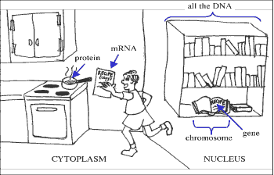
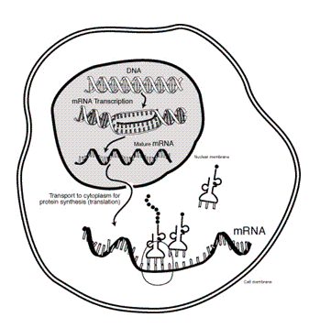
The Central Dogma of Molecular Biology has guided our interpretation of the genome
DNA
reverse transcription
transcription
RNA
translation
Protein
Source: http://www.ncbi.nlm.nih.gov/Class/MLACourse/Modules/MolBioReview/central_dogma.html
Notes:
http://genetics.thetech.org/ask/ask398

Slide 3
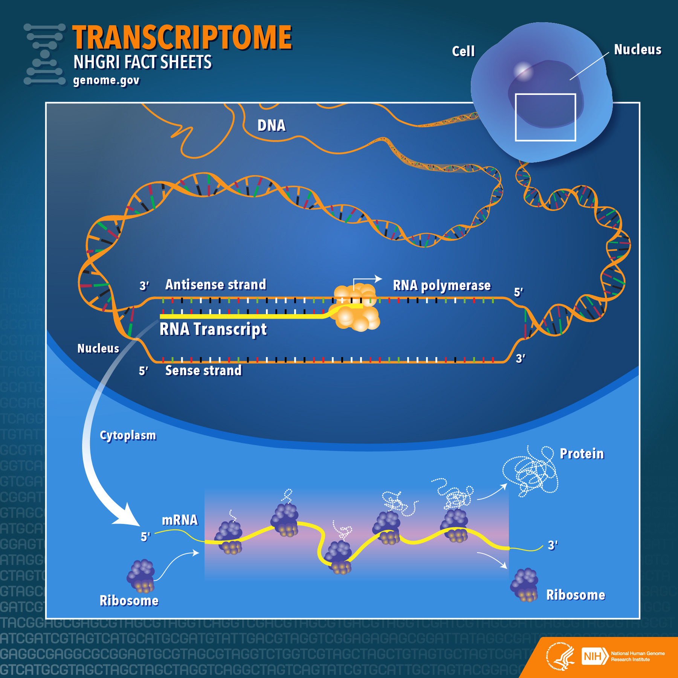
Introducing the Transcriptome
Definition: the transcriptome is defined as the entire set of transcripts produced inside a cell which is subject to a developmental stage or physiological condition.
Transcripts represents RNA molecules including mRNA, rRNA, tRNA, and other non-coding RNA like lncRNA & microRNA.
Genes are expressed or transcribed in response to a specific cell stage or physiological condition.
Understanding transcriptional changes represents a window into figuring out the functional rules of the genome.
the True Star of the Show!
NHGRI Transcriptome Fact Sheet

Slide 4
The human body is made up of different kinds of cells
Within a single human, over 200 highly-specialized cell types exist!
Almost all cell types share the same genome.
Epigenetic modification and transcription factor networks generate the mechanism for cell type-specific diversity.
A cell type's unique properties are regulated by its transcriptional program.

Slide 5
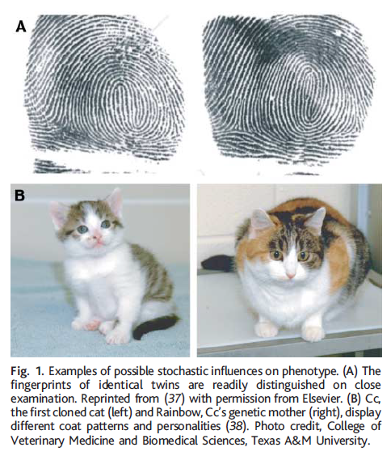
Understanding DNA variation is important but not the complete picture
In the context of crime, cats, or anything else (equally) important!
Rainbow the genetic mom
Cc the first clone
Raser & O'Shea (2005). Noise in Gene Expression: Origins, Consequences, and Control. Science.
Notes:
Gateway to improving genotype to phenotype mapping studies, understanding robustness, explaining heterogeneity.

Slide 6
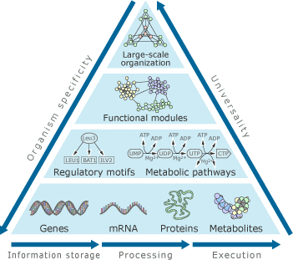
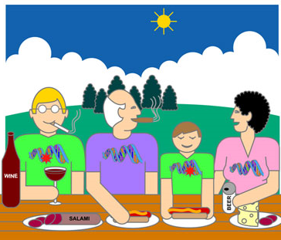
Biology is a complex system
The more we sequence, the more we recognize that there are MANY factors that contribute to how biology is regulated!
Gene x gene
Gene x environment
…
Interpreting multi-layer signals.
The goal of systems biology is to make sense of this complexity by developing predictive models and generating hypotheses that can be experimentally validated.

Slide 7
Cellular phenotypes are controlled by gene regulatory networks
Genes work together in coordinated context-specific interactions that regulate a cellular phenotype.
Networks are graphical (graph + probability) models that capture our knowledge of which interactions define a phenotype.
Our job as bioinformaticians is to integrate datasets to infer what these network models look like.
Regulatory networks
totipotent cell
pluripotent cell
lineage-committed cell

Slide 8
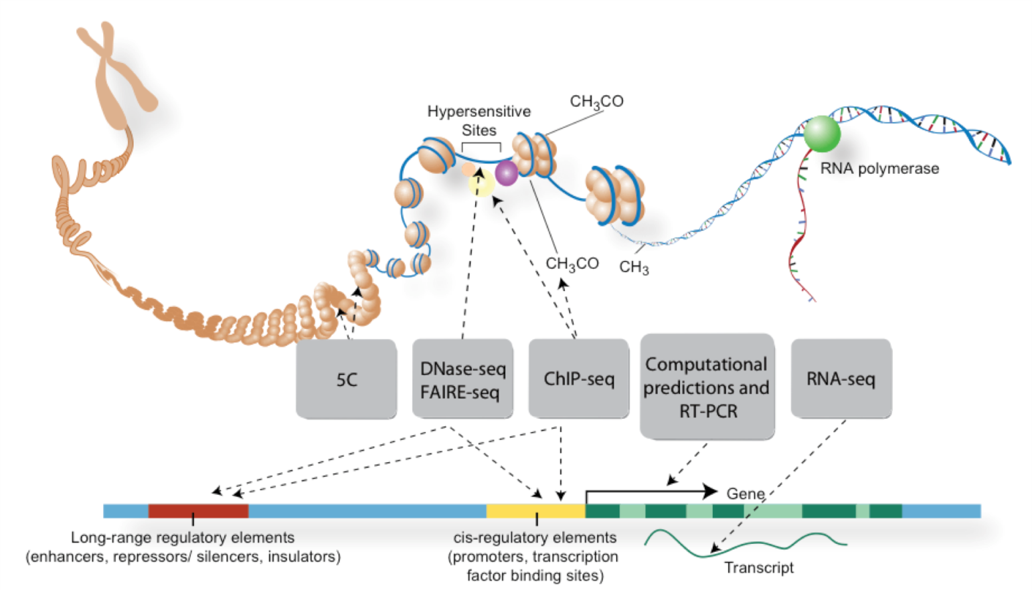
Improvements in technology continue to show that the genome is a very complex entity!
Chromatin states
DNA methylation marks
Histone marks
Structural & conformational control
GRO-seq
CAGE
ATAC-seq
Transcription factors bind to regions of DNA
Gene expression
ENCODE Project https://www.encodeproject.org/

Slide 9
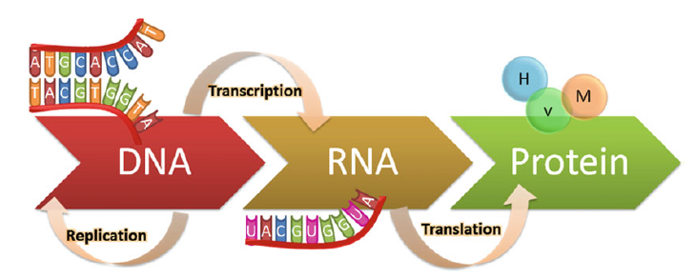
The rationale for studying RNA
RNA is another biological molecule, just like DNA.
A protein-coding gene is made into a transcript (e.g. mRNA) before being turned into a protein inside a cell.
Transcripts are copies of a gene, just like photocopies of a document.
Cells order mRNA copies of a gene to be made when that gene is required for a specific task or purpose.
The more copies (number of mRNAs), the more this gene is in demand!
Studying mRNA counts is informative for understanding how biological processes are regulated.
Overview of Gene Expression Analysis: Transcriptomics (2018).

Slide 10
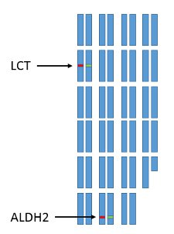

Measuring DNA variants produces binary or categorical types of data
Example: Lactose intolerance is a condition where people are unable to digest lactose (a sugar found in milk and dairy products).
Lactose is broken up by an enzyme called lactase.
The LCT gene is responsible for making lactase.
LCT is located on Chromosome 2
Homozygous
Recessive
(inherited lactose intolerance)
Heterozygous (usually no symptoms)
vs
Notes:
Inherited form of lactose intolerance is due to LCT; recessive pattern results in intolerance; heterozygnuos .

Slide 11
Measuring certain biometric variables produces continuous types of data
What is the average height of the student population at the University of Queensland?
This information is helpful when deciding how high to make the doors!
Probability Density
Height (cm)

Slide 12

Gene expression is a continuous (count) variable
Continuous data necessitates a different set of statistical analysis compared to binary/categorical data like DNA variation (see Part 2 next week!).
LCT gene example:
Probability Density
LCT gene expression
Counting the number of LCT mRNA molecules.

Slide 13
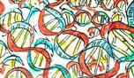
Some technologies for measuring gene expression
A Bit of
Genome
One to a few genes at a time
Northern blotting
PCR-based approaches – e.g. quantitative RT-PCR
Lots of genes in one go!
Fluidigm (hundreds)
DNA microarrays (thousands to tens thousands)
Serial Analysis of Gene Expression (tens thousands)
Chromium 10X sequencing (thousands)
All genes in one go!
RNA-sequencing
Capped Analysis of Gene Expression (CAGE)
Lots of
Genome
Genome-wide
Genome-WIDE!

Slide 14
Questions Addressed Today (& Next Week)
What are the most common platforms for collecting high-throughput gene expression data?
What are the key steps in analyzing RNA-sequencing and microarray data?
How can we learn about biology through analyzing gene expression data?

Slide 15
Let's start with technology

Slide 16
Sequencing technologies are the driving force behind the big data revolution
Muir et al. (2016). Genome Biology. The real cost of sequencing: scaling computation to keep pace with data generation.

Slide 17
RNA-sequencing is the heavy-weight amongst transcriptomics methods
RNA-seq
Microarray
Lowe et al. (2017). PLoS Computational Biology. Transcriptomics technologies.

Slide 18
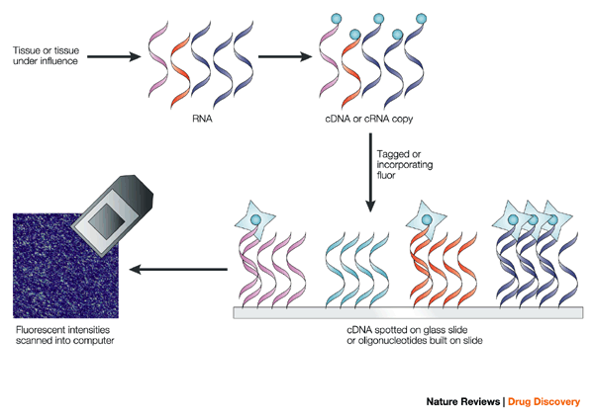
But big data really started with microarrays…
Reverse transcription
Extract total RNA
Major Microarray Platforms
Affymetrix
Illumina
NimbleGen
Agilent
Great (short) video intro!
https://www.youtube.com/watch?v=0ATUjAxNf6U
Butte. (2002). Nat Rev Drug Discovery. The use and analysis of microarray data.

Slide 19

Standard pipeline for microarray pre-processing
e.g. CEL files (Affymetrix) or BeadStudio output (Illumina)
Raw Data
Bioconductor R packages:
lumi (Illumina)
affy (Affymetrix)
oligo (NimbleGen, Affymetrix)
also
affyPLM, gcrma, affycomp, affypdnn
Background Correction
RMA method (Irizarry et al.)
Variance stabilization
Log2()
Transformation
Normalization
The process of correcting for technical variation in data so that different samples are comparable.
Quantile
Rank-invariant
Loess
Analysis!
(the fun part, of course)

Slide 20
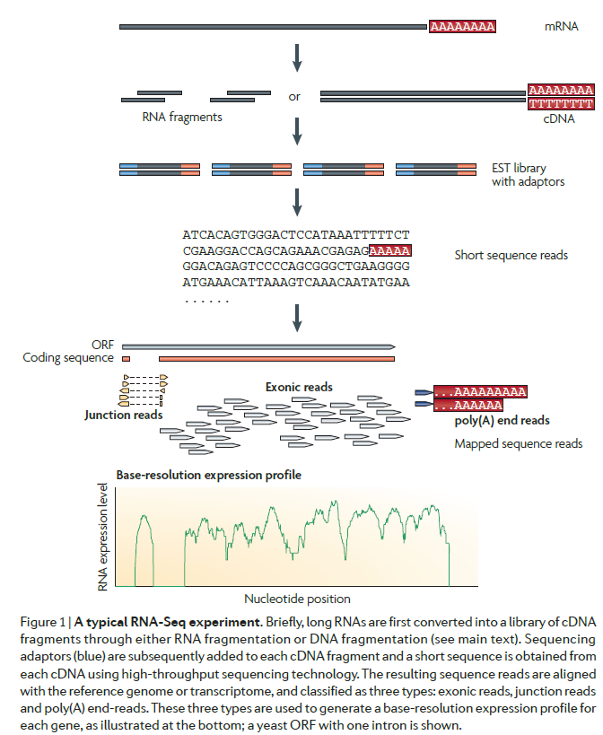
RNA-sequencing technology basics
Illumina video:
https://www.youtube.com/watch?v=fCd6B5HRaZ8
Wang et al. (2009). Nature Reviews Genetics. RNA-seq: a revolutionary tool for transcriptomics.

Slide 21
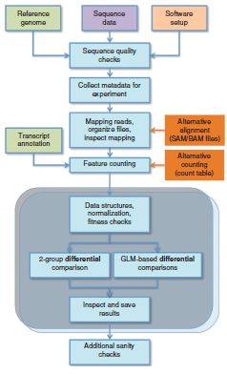
RNA-seq analysis pipeline (simplified version)
Bioconductor R packages:
edgeR
DESeq, DESeq2
Specialized Platforms:
monocle (single cell)
Wang et al. (2009). Nature Reviews Genetics. RNA-seq: a revolutionary tool for transcriptomics.

Slide 22
RNA-sequencing: breaking down the steps!
Lowe et al. (2017). PLoS Computational Biology. Transcriptomics technologies.

Slide 23

Microarray vs RNA-sequencing
The size of the advantage depends on the biological question being asked!
In general, key advantages (Table 1) have driven the uptick in RNA-seq versus microarray-based applications.
Lowe et al. (2017). PLoS Computational Biology. Transcriptomics technologies.

Slide 24
Using RNA-seq to learn about the transcriptome
Sequencing methods allow for new lines of investigation.
Quantify differential expression, isoform abundance, non-coding RNAs, RNA editing, splicing, SNPs, etc.
Haas and Zody. (2010). Nature Biotechnology. Advancing RNA-seq analysis.

Slide 25
Despite the different applications, the preprocessing steps are generally similar
Conesa et al. (2011). Genome Biology. A survey of best practices for RNA-seq data analysis.

Slide 26
Technology platforms for next-generation sequencing
New platforms and technologies continue to be released at rates that no publication can capture accurately.
Lowe et al. (2017). PLoS Computational Biology. Transcriptomics technologies.

Slide 27
Resources to study gene expression – what's in this for you?

Slide 28
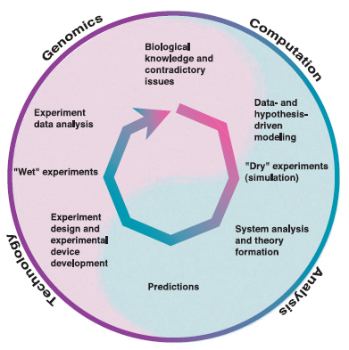
How systems biology fits into the general scientific method
Identify a testable hypothesis.
Identify the data set(s) or experimental design under which this hypothesis can be tested.
Conduct statistical analysis.
Interpret results and acknowledge limitations.
Kitano, Science (2002): vol. 295 no. 5560.

Slide 29
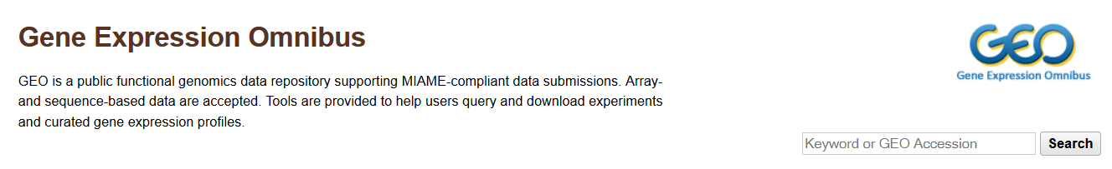
Got questions? Ask the data!
A wealth of gene expression data is publicly available in the form of repositories, the largest being GEO, and is hosted by the NCBI at the NIH.
All expression data stored in GEO follows a standard format called MIAME which was created to ensure the experimental details were available.
Easy links to the paper that describes the study that generated the data.
Data can be downloaded in normalized (good to go!), or raw formats.
NCBI has many databases that store specific genomic information.
dbSNP
dbGAP: database of Genotypes and Phenotypes
SRA (Short Read Archive)
http://www.ncbi.nlm.nih.gov/

Slide 30
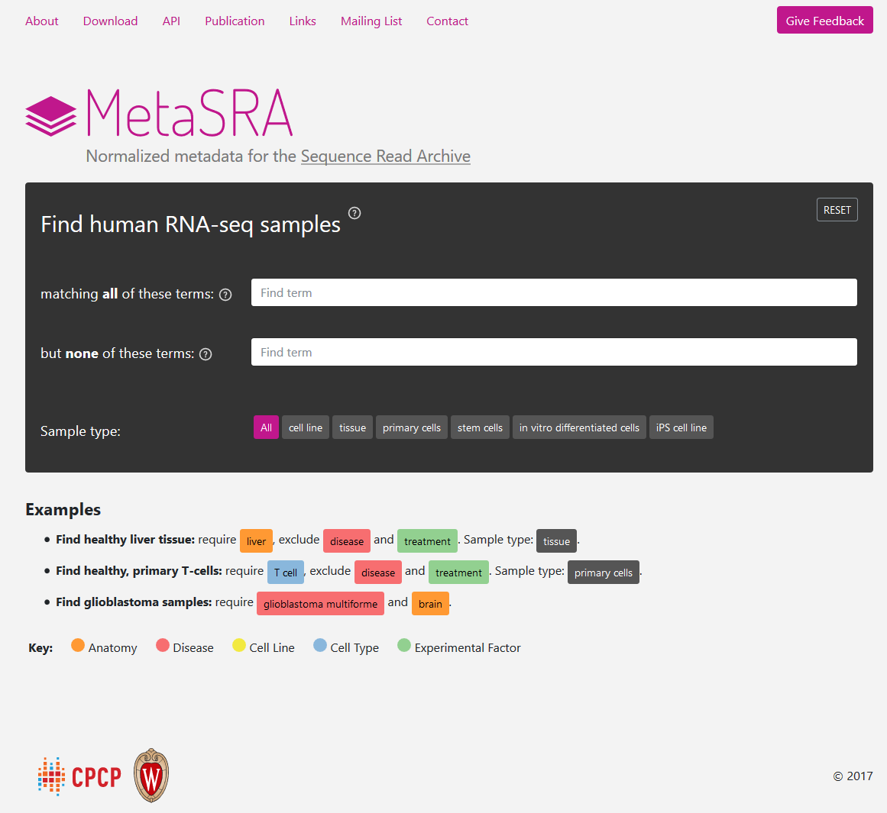
Specialized databases continue to be added…
http://metasra.biostat.wisc.edu/

Slide 31
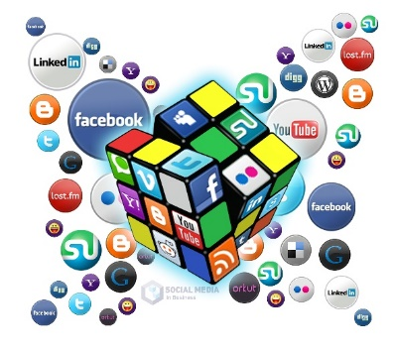
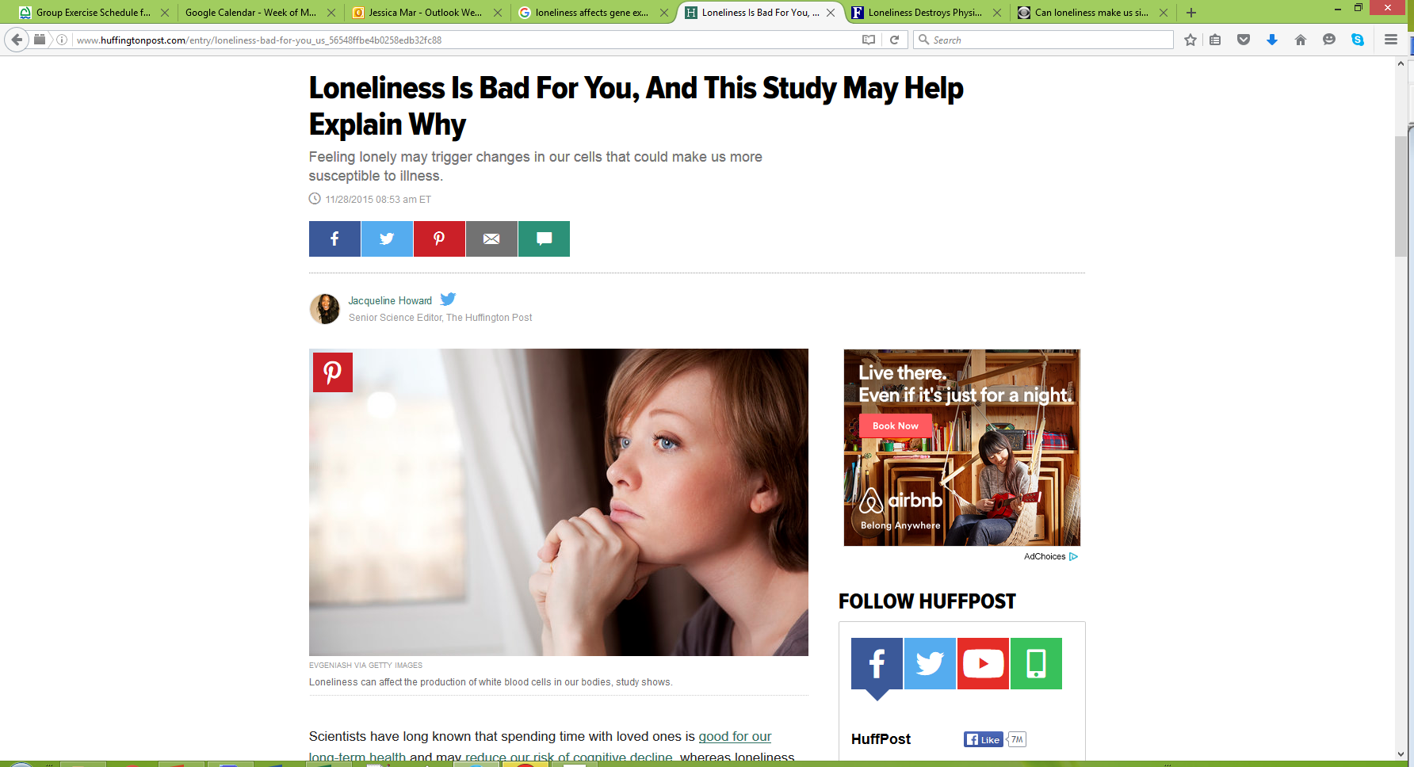
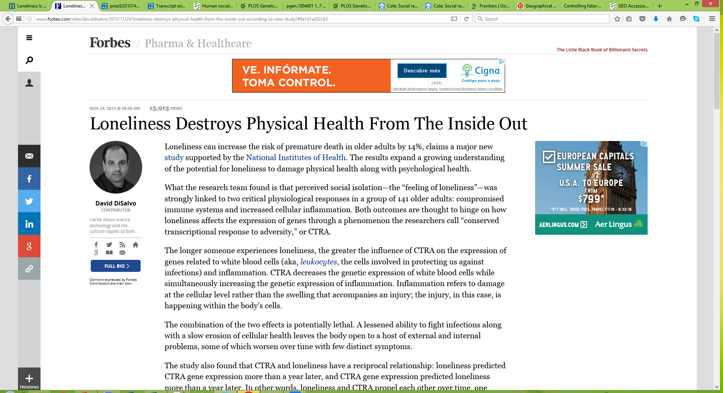
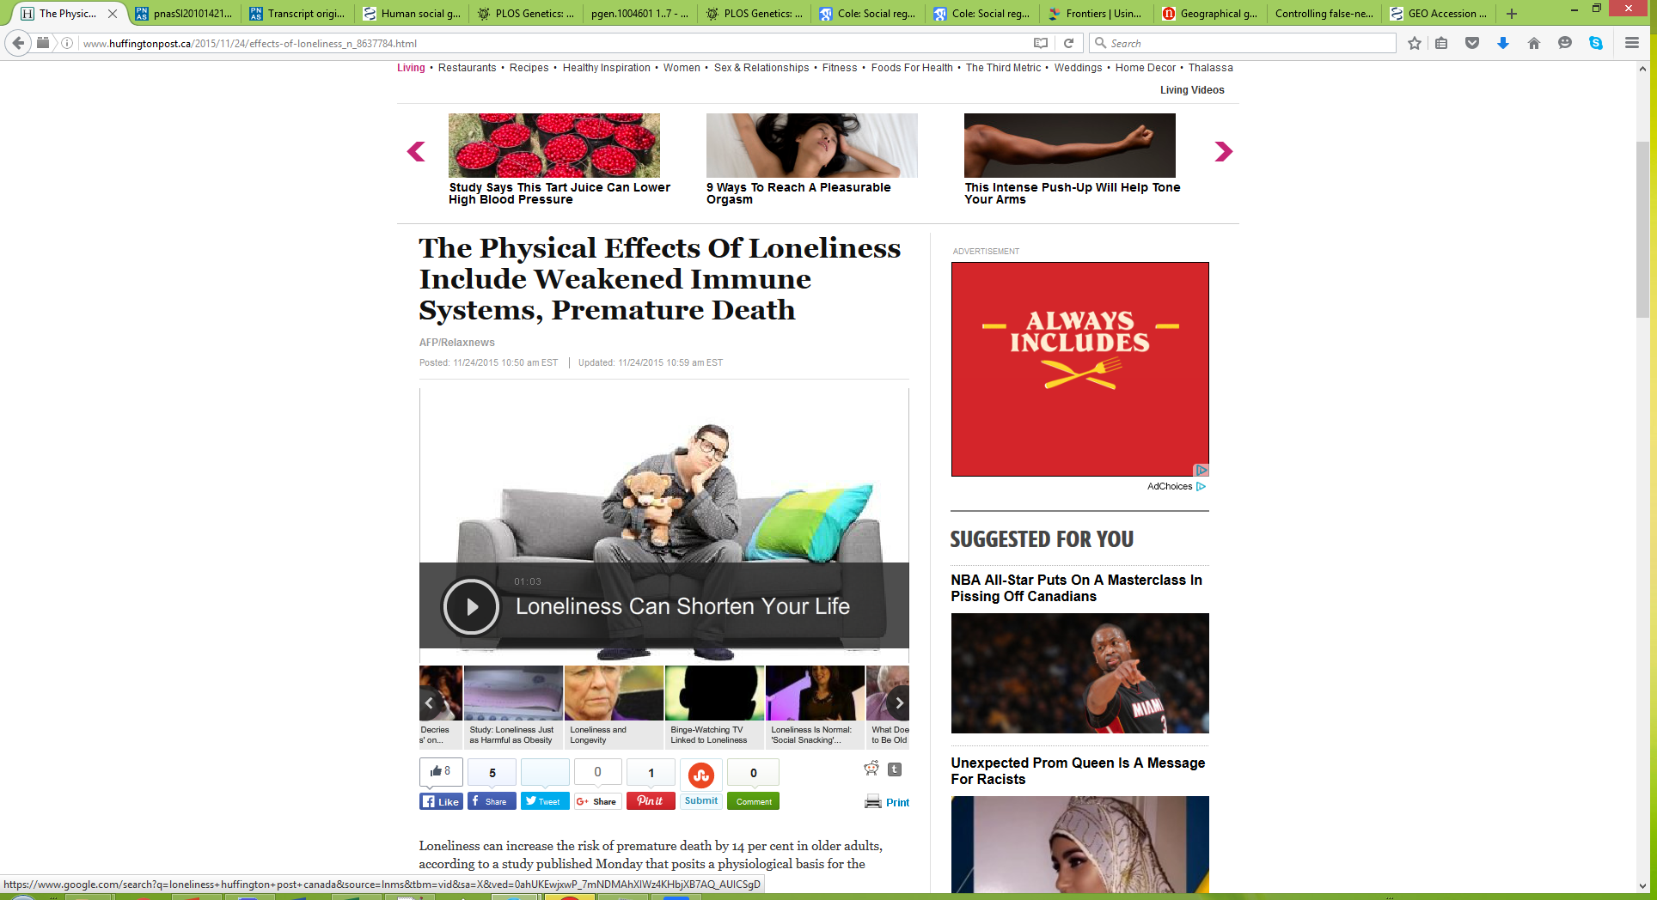
Social Genomics – Loneliness, Happiness and Science?!
An emerging area of social science deals with the intersection of happiness/loneliness and the impact on human health. More recently, this field has taken a quantitative molecular approach, giving rise to “social genomics”.

Slide 32
Do Social-Environmental Factors Influence Our Gene Expression?
Proponents of human social genomics argue that social-environmental conditions can affect differential expression of genes in leukocytes.
Circulating leukocytes are a mixed population of cells, responsible for pathogen recognition, immune response and tissue repair.
Adverse social conditions (loneliness, bereavement, depression) have shown to affect leukocyte gene expression.
How do social environments regulate immune function?
Cole SW. (2014). Human Social Genomics. PLoS Genetics.

Slide 33
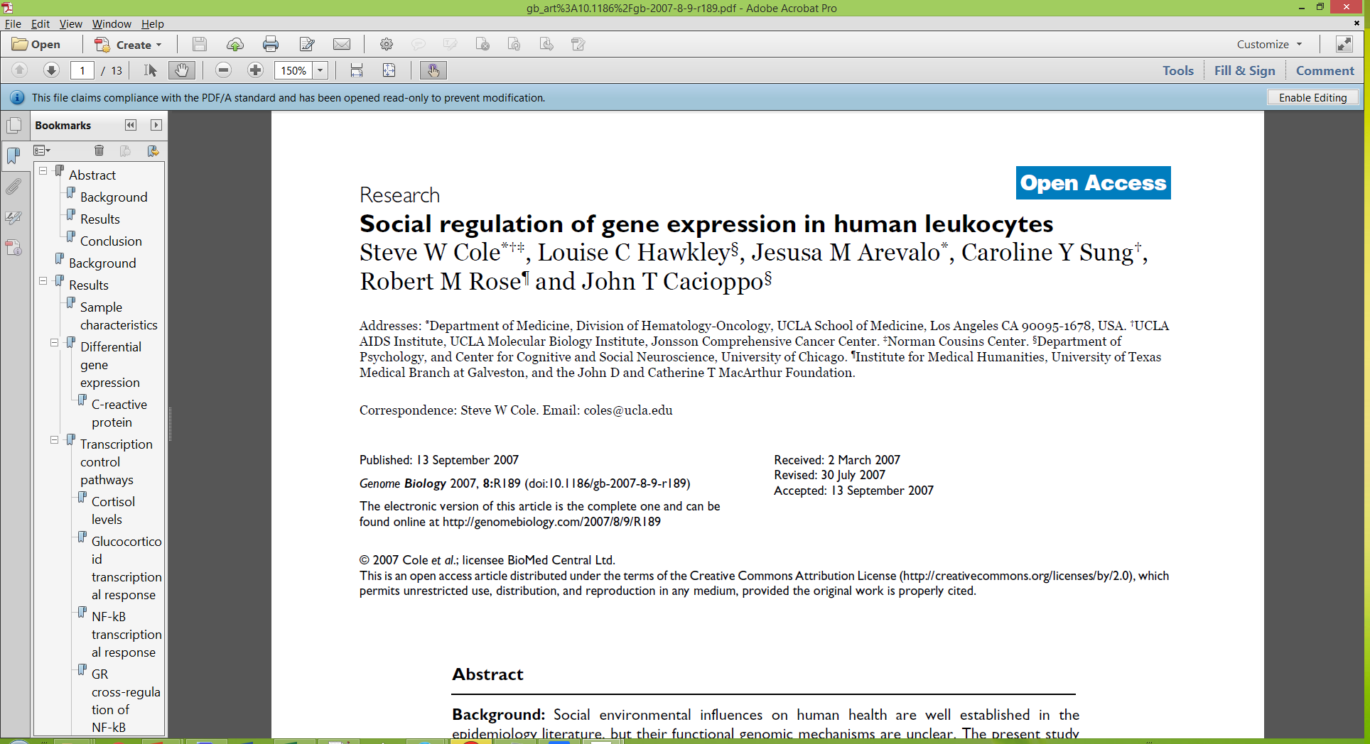
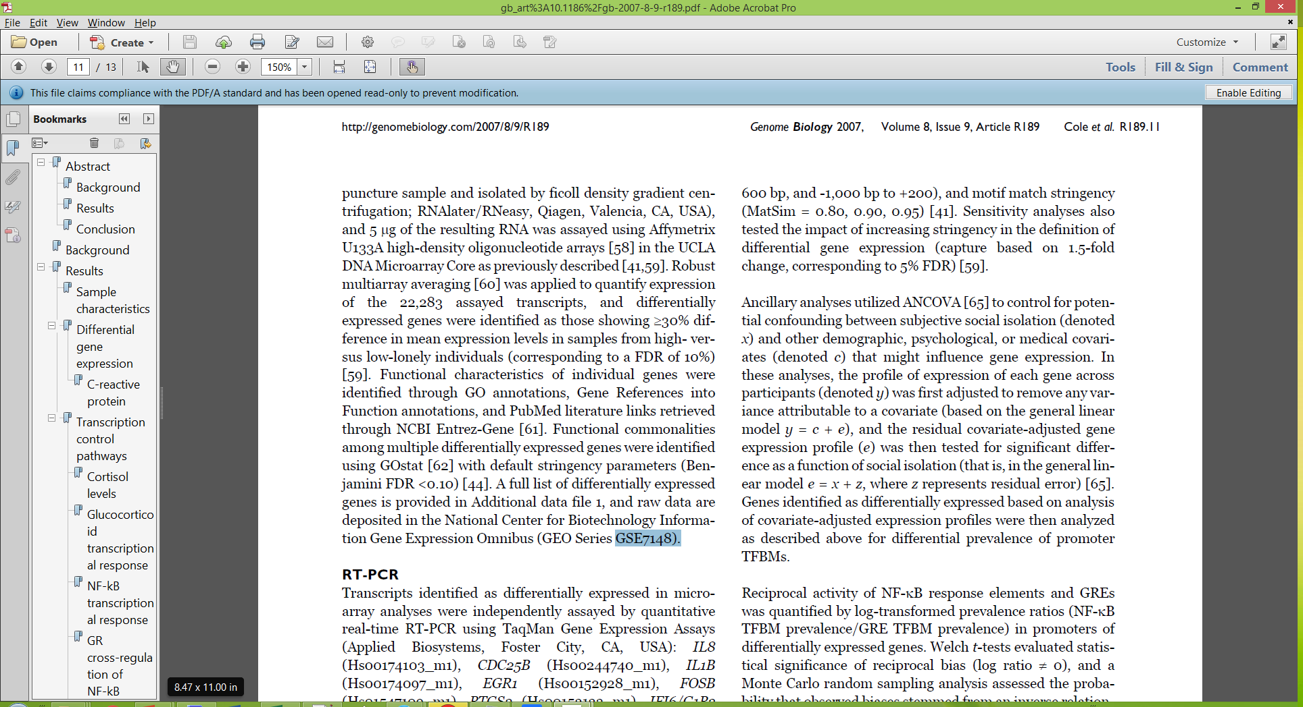
Retrieving data from GEO is straightforward
from the Methods section
R package GEOquery allows you to download GEO data into a Bioconductor package seamlessly.
> library(GEOquery)
> dat <- getGEO("GSE7148")
Getting information about a package:
> library(help=GEOquery)
To install any Bioconductor package:
> source("http://www.bioconductor.org/biocLite.R")
> biocLite("GEOquery")

Slide 34
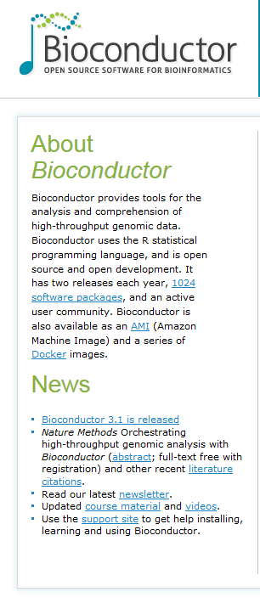
The Bioconductor Project – A Bioinformatics Standard
This project has become the standard repository for R software that deals with all things bio.
A big theme of Bioconductor has been the standardization of data classes to make analysis of –omic data easier, more robust and more reproducible.
The project makes available packages that deal with:
Annotation
Statistical Methods
Pre-processing Approaches
Vignettes will change your life!
http://bioconductor.org

Slide 35
Lecture Summary
RNA-sequencing and microarrays are generally used for high-throughput gene expression data, with the former eclipsing the latter.
Pre-processing of RNA-seq data requires alignment of reads, transcript identification and quantification.
RNA-seq allows us to capture information about mRNAs but also other RNA molecules.

Slide 36
Additional Take-aways
RNA-seq allows us to capture information about mRNAs but also other RNA molecules.
For a beginner, it is easier to learn how the pipelines work by starting with bulk RNA-seq data.
Innovative methods exploit the advantages of gene expression datasets – this is a space for amazing science that you could even do from home!
Bioinformatics-driven science is a reality.
Opportunities exist to use publicly accessible datasets to act on your curiosity!
So, what are you curious about?

Slide 37
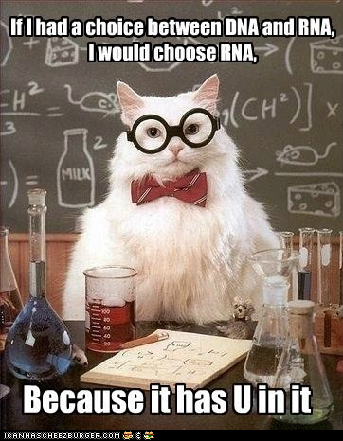
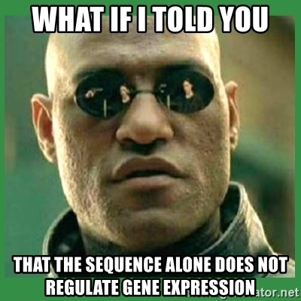
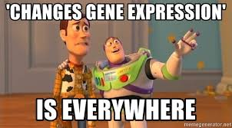
Please check out Part 2 and see you next week for our online lectorial!
AIBN (Building 75) Level 4 West
Email: j.mar@uq.edu.au
Notes:
URLs for memes:
http://fr.memegenerator.net/instance/37704741/matrix-morpheus-what-if-i-told-you-that-the-sequence-alone-does-not-regulate-gene-expression
https://memegenerator.net/instance/46733805/consequences-toy-story-changes-gene-expression-is-everywhere
https://www.pinterest.com.au/pin/173388654379979283/

